Slide 1

Datenintegration – 1st. Phase
Johannes Gesk
Niklas Standop

Slide 2

Showcase
Original Idea: Economic correlated data
Problem:
data hard/barely to get or expensive
Data not sufficient, might become a problem in the project

Slide 3
Public Transport Verkehrsverbund Bremen/ Niedersachsen
GTFS data provided by the public transport
Open data
Target and actual data for time on the trips
2020-2021: Corona
2022: 9€ Ticket
2023: Post Corona
Overall Goal: How will the delays evaluate with the 49€ Ticket and Post Corona?

Slide 4
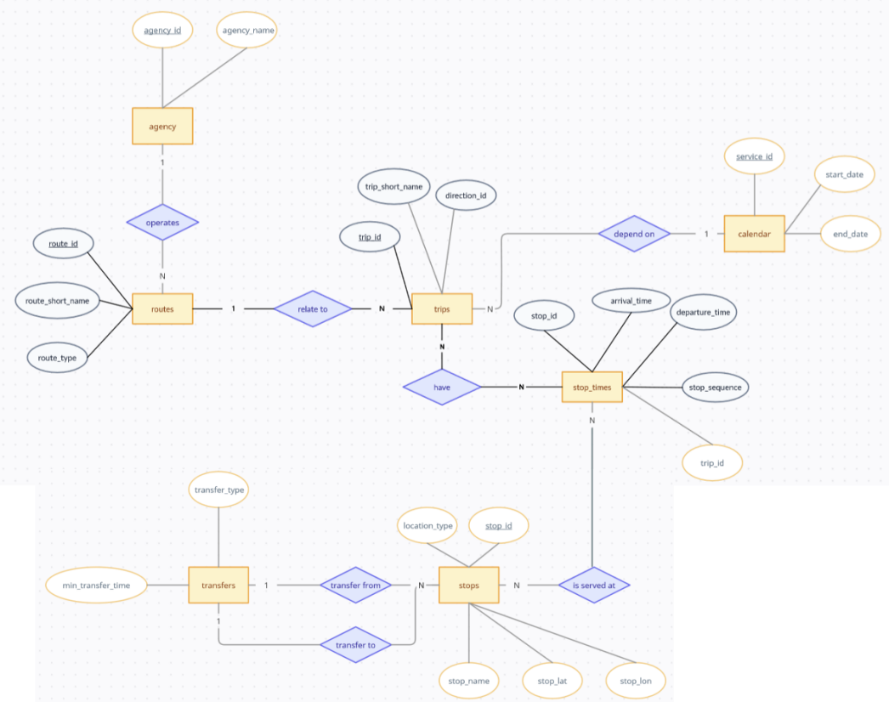
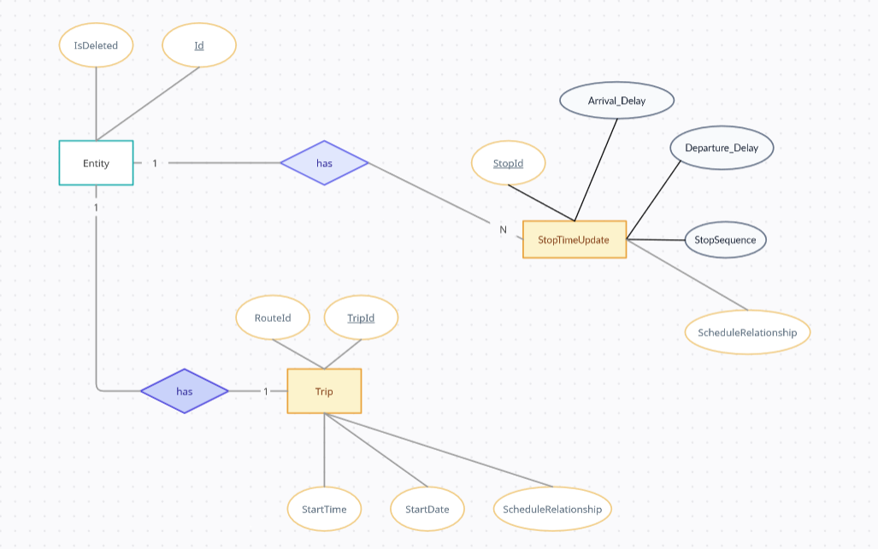
How to? Current status on ER

Slide 5
Next up:
Get more data for the years 2020 until 2022
Get the correlations and the exermine the important data out of the source.

